Slide 1

CV GENERATOR

Slide 2
PRESENTED BY Zahin Raidah Maisha (170042032) Nafisa Mehjabin (170042033) Khandaker Rifah Tasnia (170042042)

Slide 3




WHAT IS A CV GENERATOR?
z
Curriculum vitae (CV) is a written overview of a person's experience and other qualifications. In some countries, a CV is typically the first item that a potential employer encounters regarding the job seeker and is typically used to screen applicants, often followed by an interview. CV Generator is a web-based application program that creates and processes a CV for the user.

Slide 4


WHY DO WE NEED IT?
Professional CV
Not missing important details
Elegant presentation of CV
Saving time

Slide 5
FEATURES
Current Goal :
Several templates to choose from
A preset pattern, where entering input is easy
User-friendly UI design
Download option in multiple formats (Word, PDF)
Information stored safely
Generate Cover letter along with CV
Sections can be edited, added, deleted

Slide 6

FEATURES
Future Goals :
Increasing the number of templates
In future, the user will be able to create his/her own template
Multiple CV and Cover letters can be generated by one account
Rate and review option for users
Keep track of CVs and efficiency rates

Slide 7

PROGRAMMING LANGUAGES AND SOFTWARES
Programming Language : PHP
Web designing Language : HTML, CSS, JavaScript
Database Management System : MySQL
Database Hosting : Xampp

Slide 8
TIMELINE
DECEMBER – JANUARY : Team formation and Idea Development
JANUARY - FEBRUARY : User Interface Design and Schema Design
FEBRUARY – MARCH : Web page design
MARCH – APRIL : Database management and linking database with our web page
APRIL – MAY : Development

Slide 9
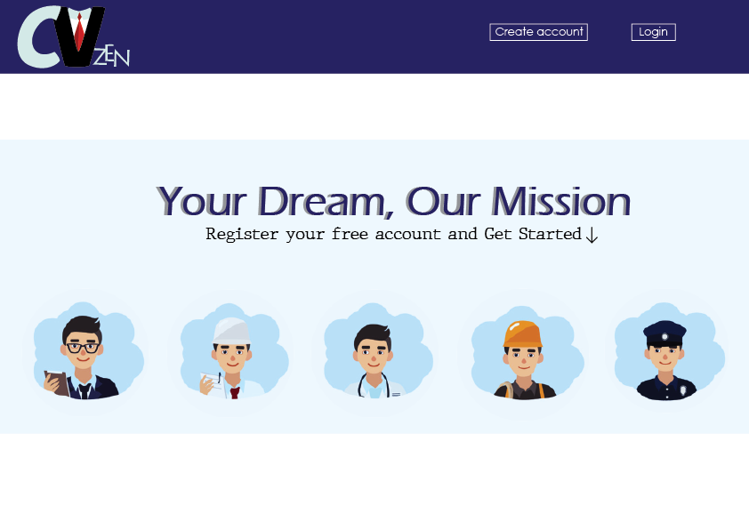

UI DESIGN
Homepage
z

Slide 10
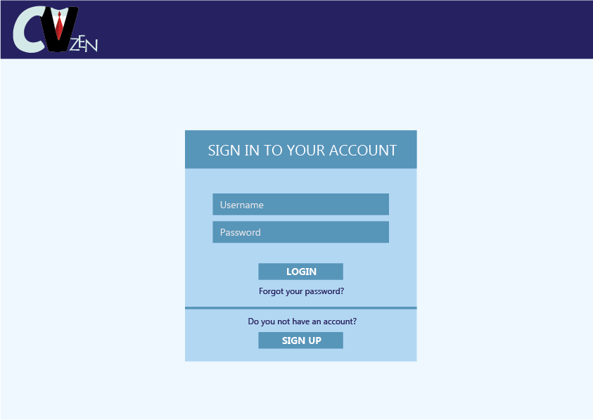
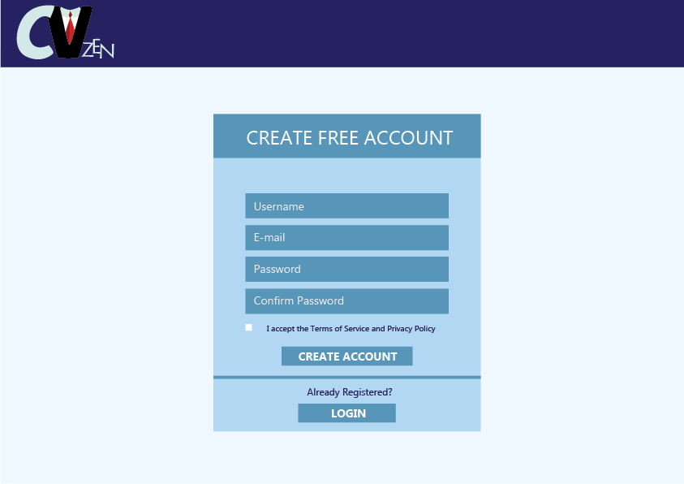
UI DESIGN
Login Sign UP
z

Slide 11
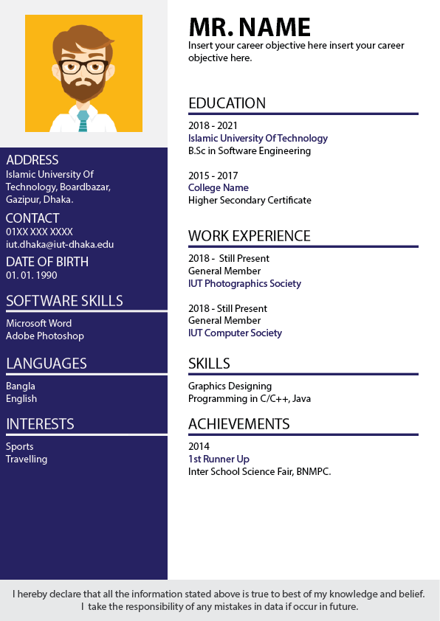
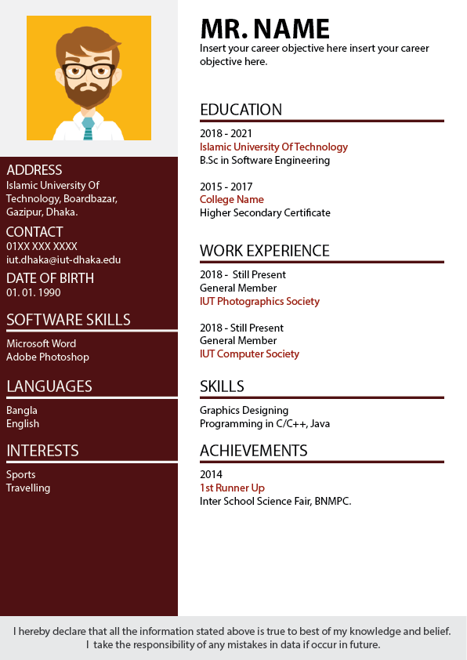
UI DESIGN
Template
z

Slide 12
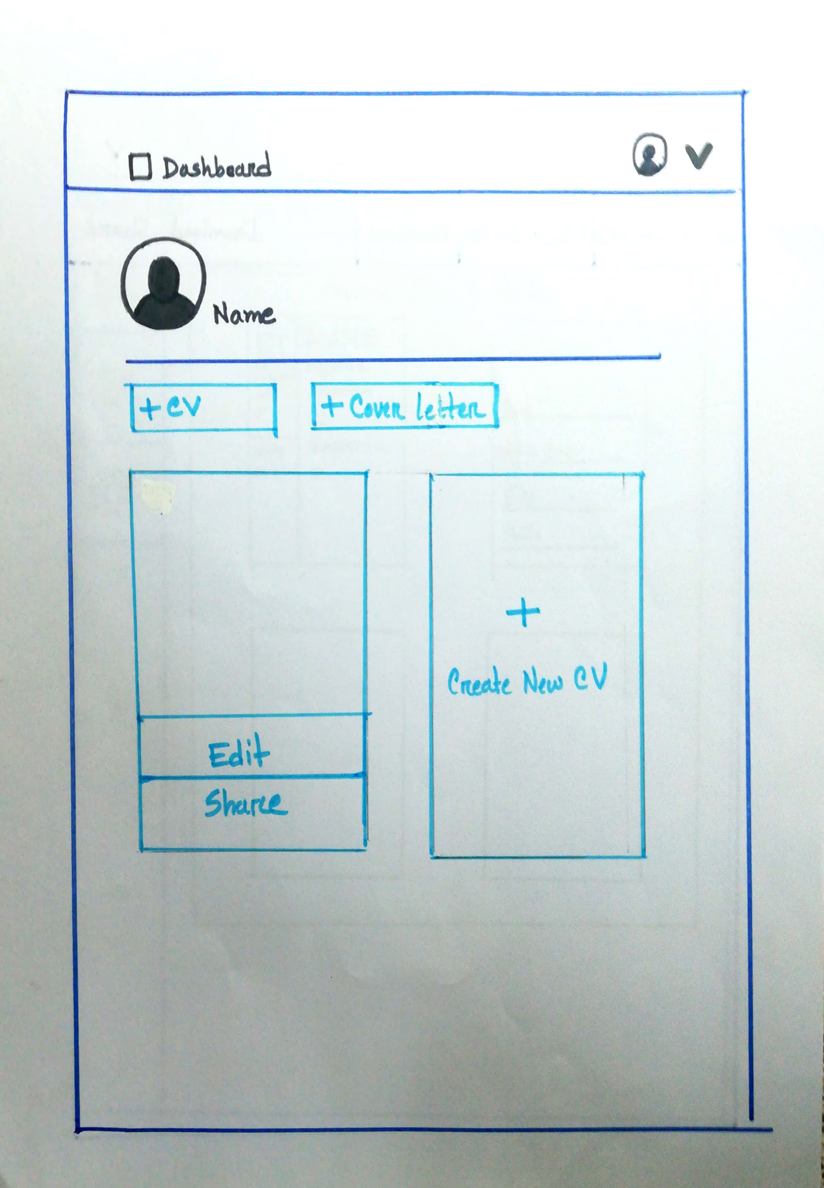
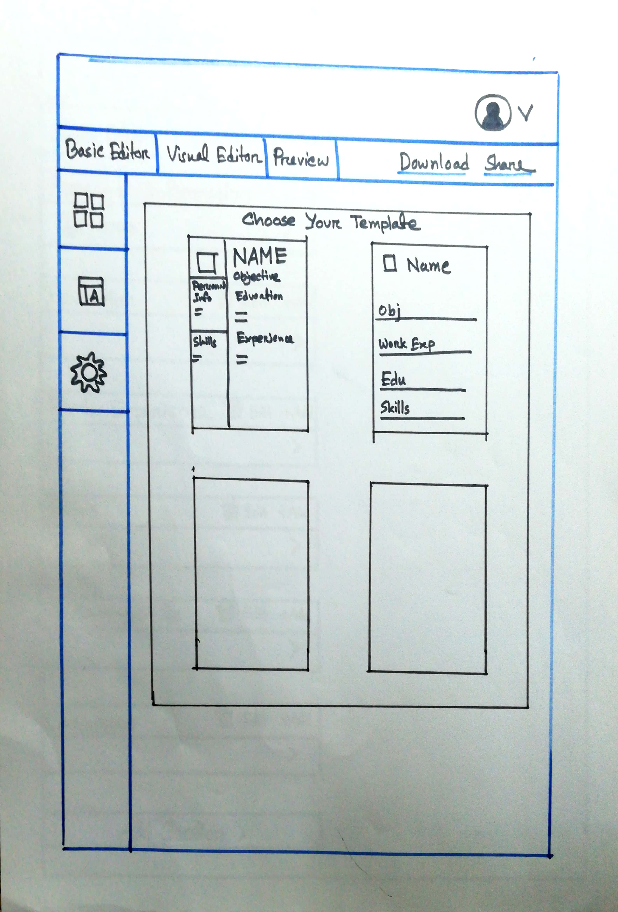
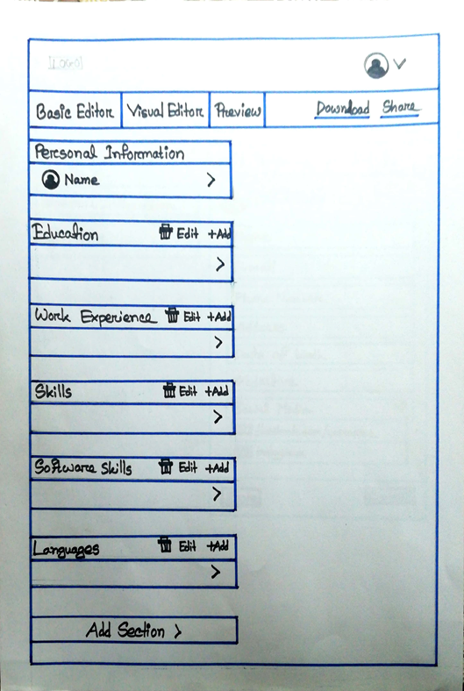
UI DESIGN
Dashboard Visual Editor Basic Editor
z

Slide 13
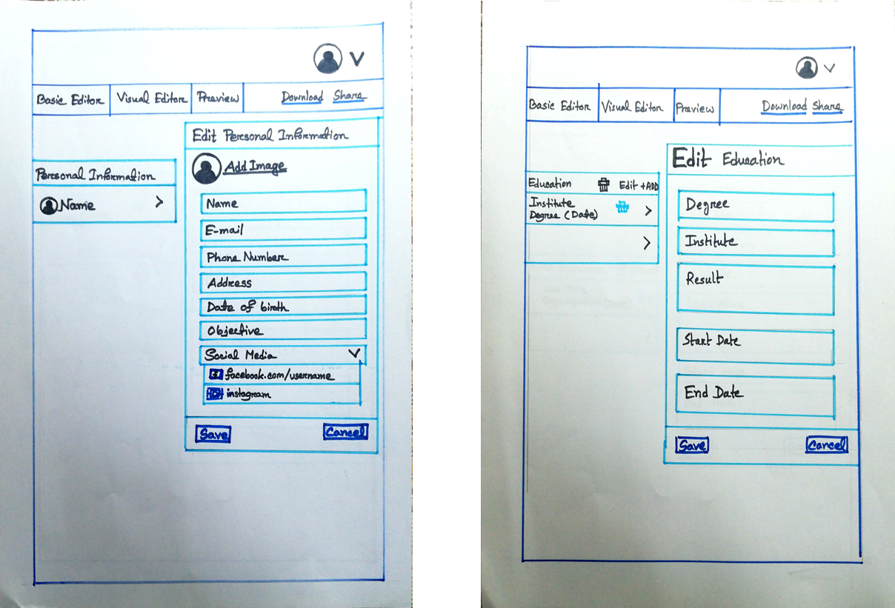
UI DESIGN
Personal Information Education
z

Slide 14
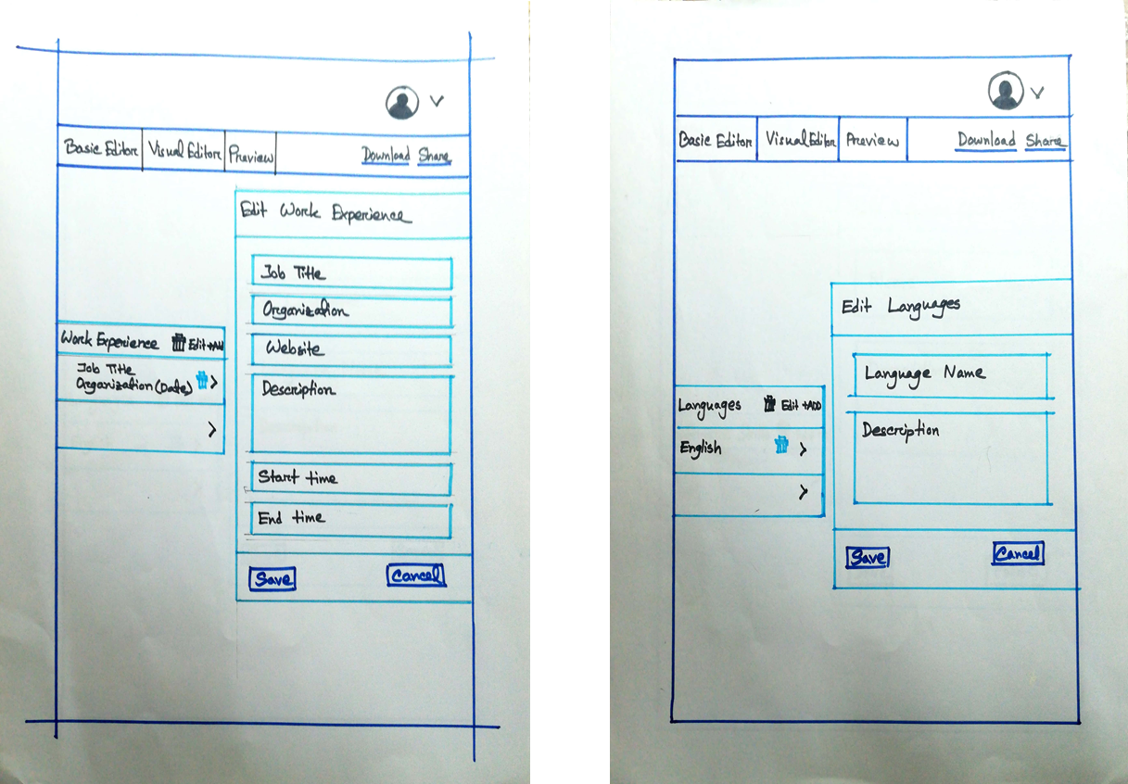
UI DESIGN
Work Experience Languages
z

Slide 15
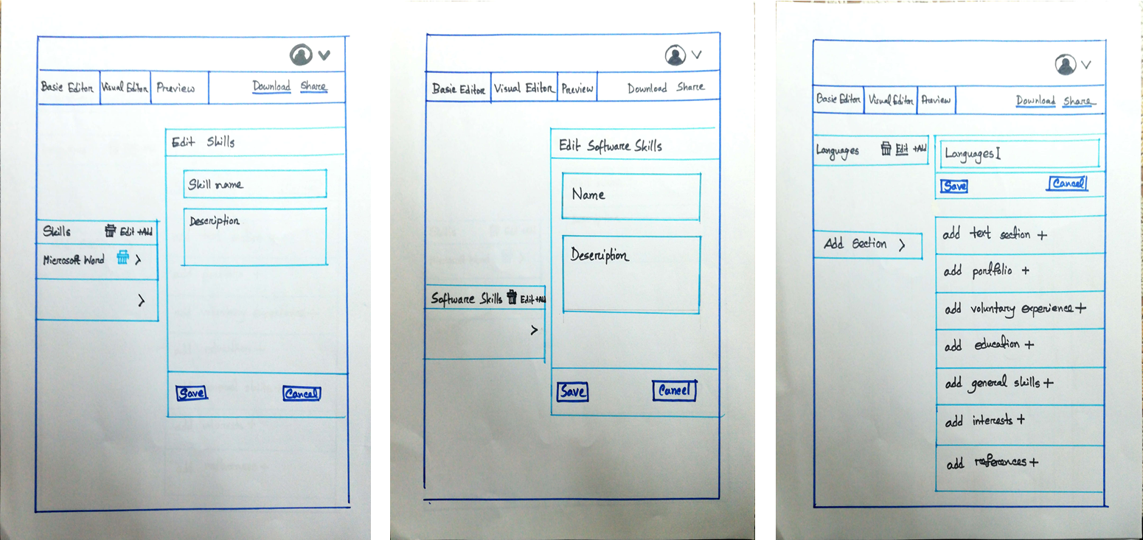
UI DESIGN
Skills Software Skills Section name edit
& Add Sections
z

Slide 16
THANK YOU
z

